Slide 1

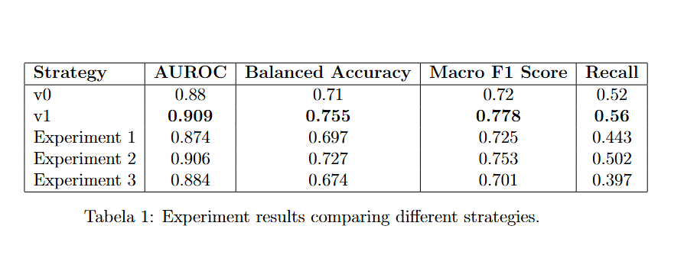
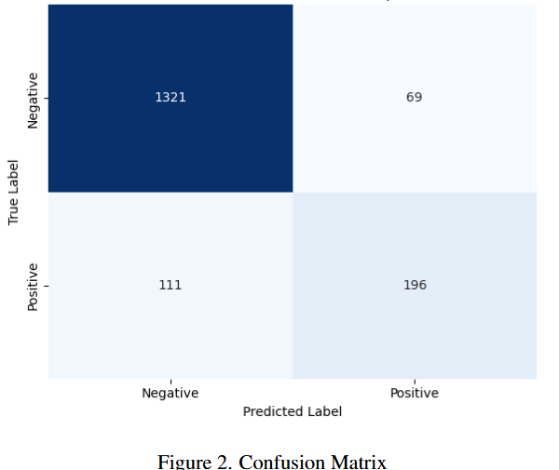
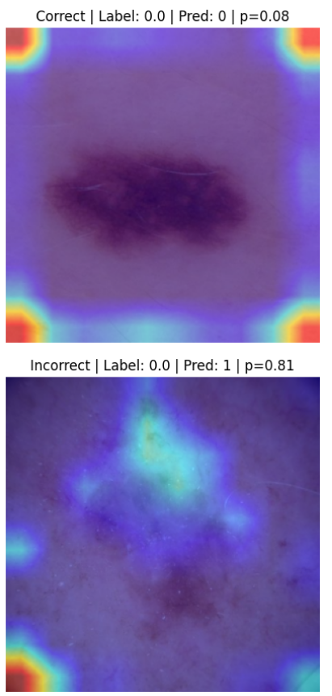
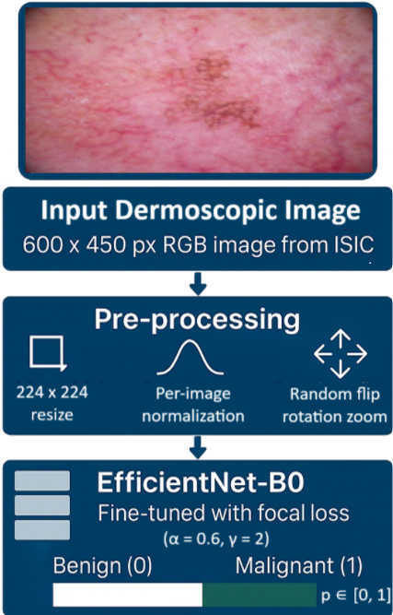
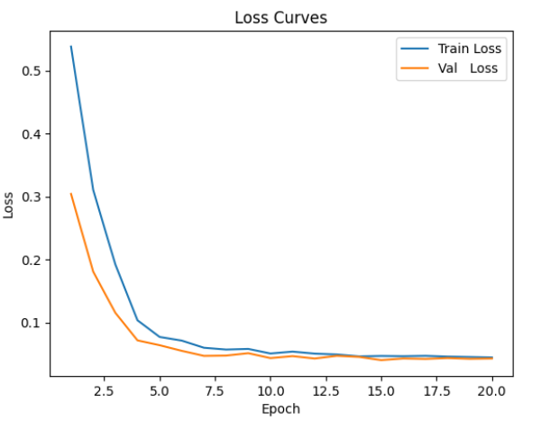

Skin Cancer Detection using Convolutional Neural Networks
Pedro Silva (64926) Pedro Diz (64852)
M.Sc. Computer Engineering
Deep Learning class 2024/2025
Objectives
Results
Determine whether a given skin lesion exhibits malignant characteristics.
Address class imbalance.
Build a data pipeline for dermoscopic image classification using ISIC 2018 data.
Problem
Portugal has a hot climate and extensive beach culture, leading to high sun exposure, which significantly increases the risk of skin cancer [1]. Early detection is crucial, as it greatly improves the chances of successful treatment while reducing long-term damage and increasing survival rates [2].
Methodology
Experiment 1 - Shades of Gray Preprocessing: Applied the Shades-of-Gray color normalization before resizing. Aimed to improve robustness to lighting variations. Trained B0 for 15 epochs.
Experiment 2 - EfficientNet-B3 @ 300² : Switched to EfficientNet-B3 and resized images to 300×300. Total 15 epochs training.
Experiment 3 - MixUp 0.2: Added MixUp (α=0.2) to the augmentation pipeline. Trained B0 for 15 epochs to reduce overfitting.
The dataset was significantly skewed toward benign lesions. To address this, we used weighted random sampling, which improved recall from baseline levels to 0.56.
Across experiments, our baseline v1 consistently achieved the highest AUROC(0.906), alternative augmentations underperformed it.
Youden’s point improves over the default 0.5 threshold by accounting for actual class distribution and model behavior. While it doesn’t directly prioritize malignant cases, it often finds a better balance when classes are imbalanced, which is still more clinically useful than a fixed cutoff.
For future work, 5-fold patient-level cross-validation would improve reliability. Our current split depends on a single partition, which may bias results, miss variance, or suffer from unbalanced/easy-hard case distributions. Limited compute prevented this in the current study.
Conclusions
Datasets
The ISIC 2018 Task 3 dataset is a dermoscopic image set for classifying skin lesions into 7 types, including melanoma and benign nevi. It contains 11.7k labeled images split into training, validation, and test sets. Images are JPEGs (600×450 px), with class imbalance (81.37% benign and 18.63% malignant).
References
Acknowledgements: This poster session is kindly sponsored by:
[1] Tenchov, R., Sasso, J. (2024). How biomarkers unlock faster cancer detection, improving outcomes
[2] IPO Lisboa (2024). Cancro da pele é dos mais frequentes em Portugal

